Slide 1

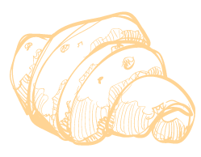
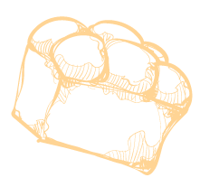

The Breadboard Bakery
SYD366NEE Group Assignment
Group 4
John Richard Bozar | Rickson Bozar | Diego Felipe | Luca Novello

Slide 2
Introduction
Tasks:
Design a customer-facing website for Victoria’s Breadboard Bakery.
Add a “Create User Account” feature to the website.
Add a “Place an Order” feature to the website.
Create a Class diagram with the required classes.
Create mockups of interfaces for both new features.

Slide 3
01
Class Diagram

Slide 4
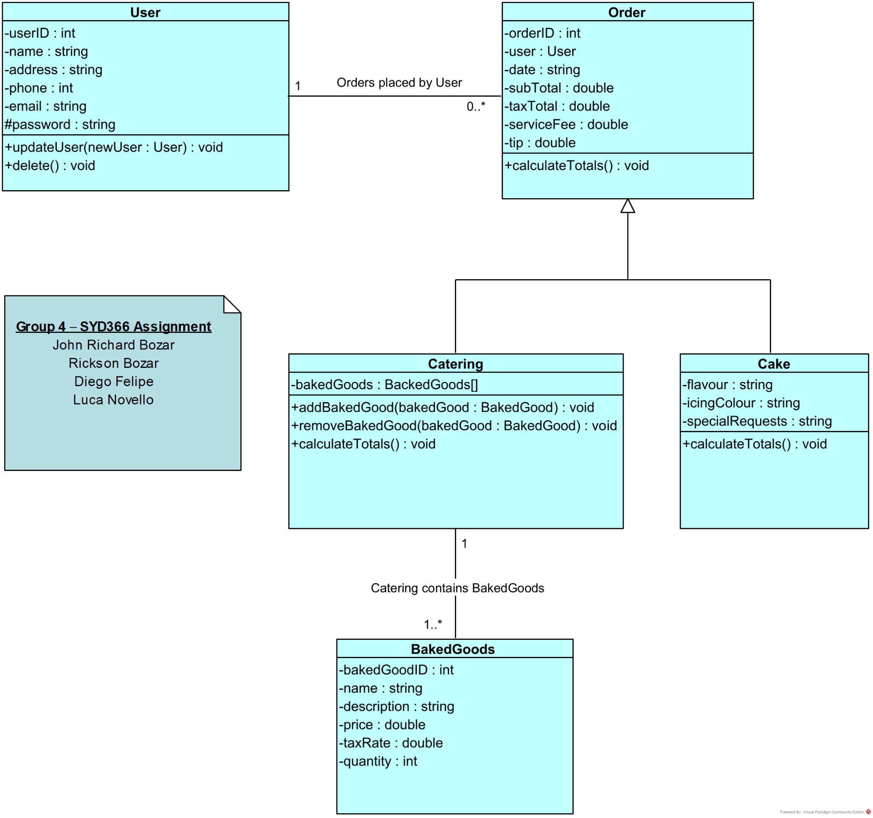
Class Diagram

Slide 5
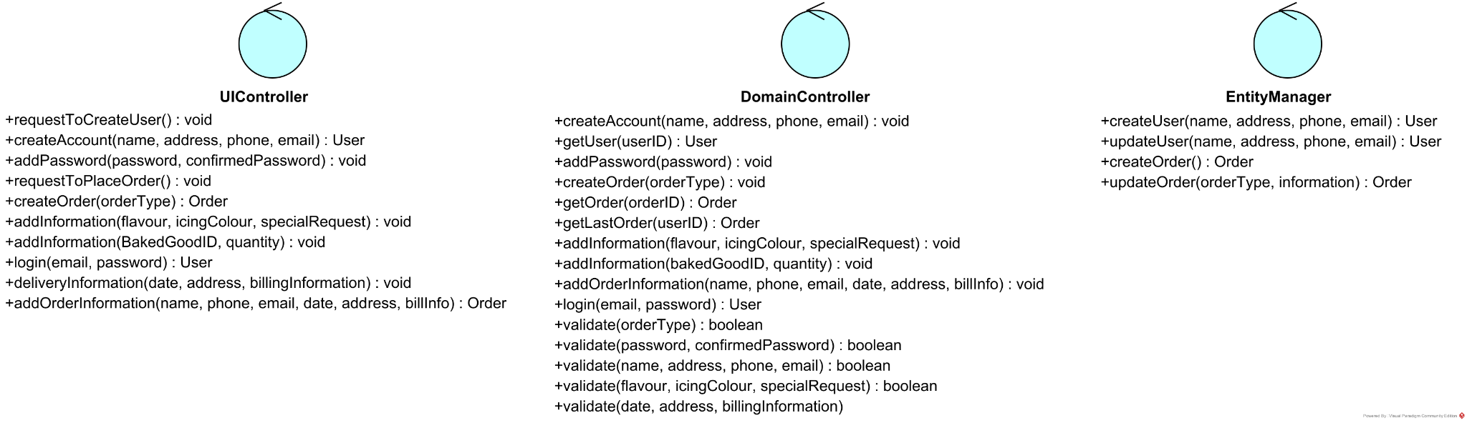
Controller Class Diagram

Slide 6
02
Create User Account

Slide 7
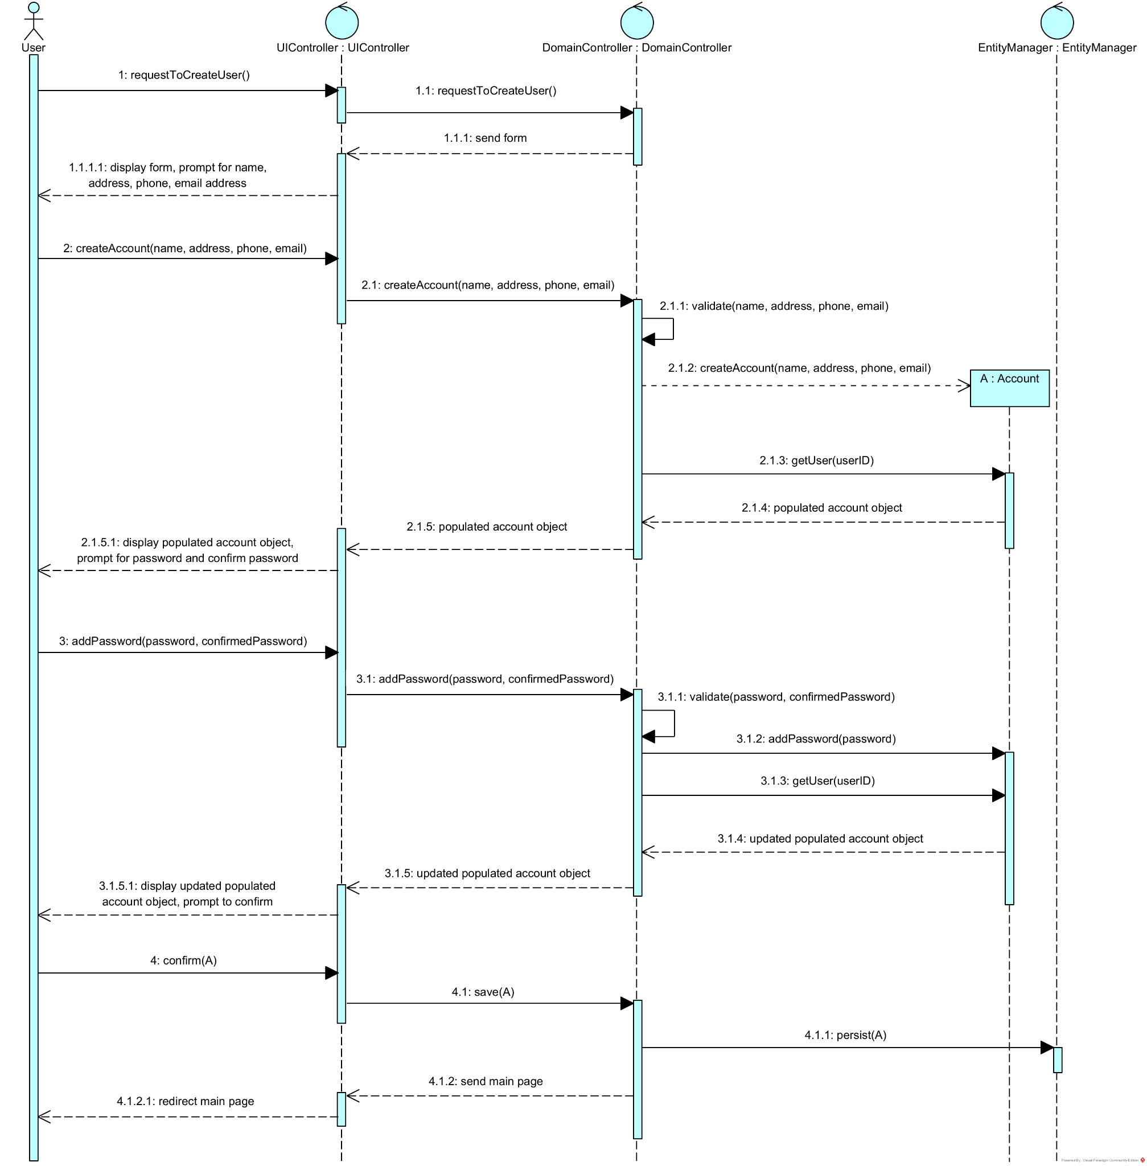

Sequence Diagram: Create User Account

Slide 8
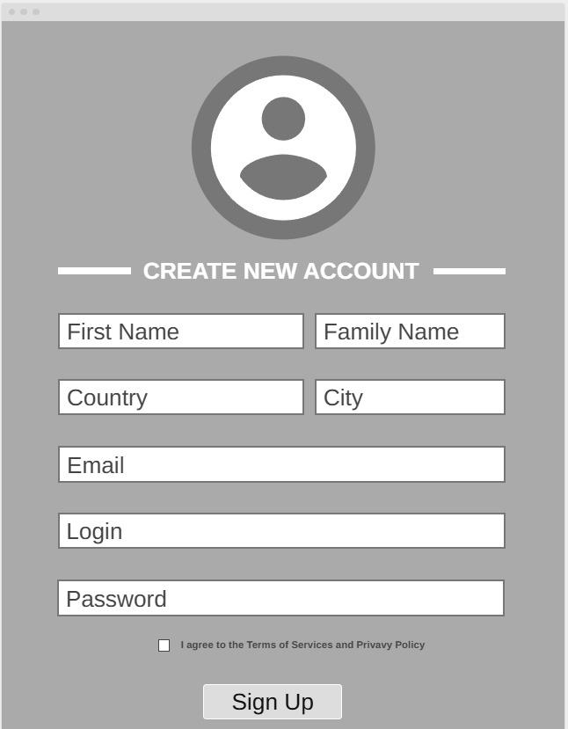
Mockup: Create User Account

Slide 9
03
Place an Order

Slide 10
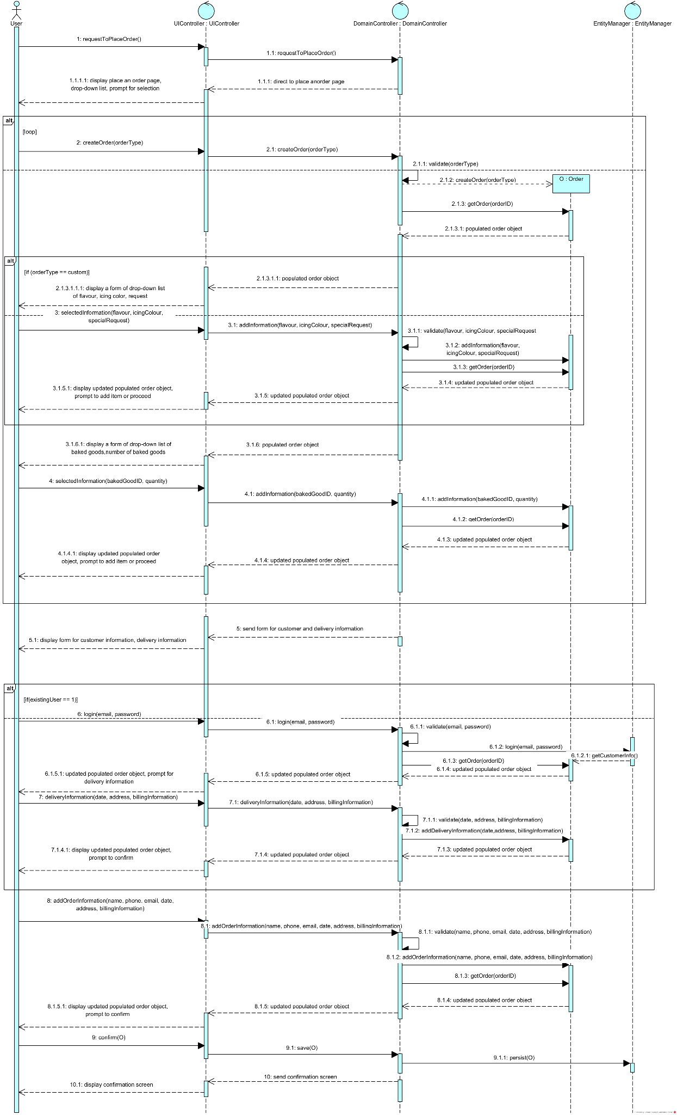
Sequence Diagram: Place an Order

Slide 11
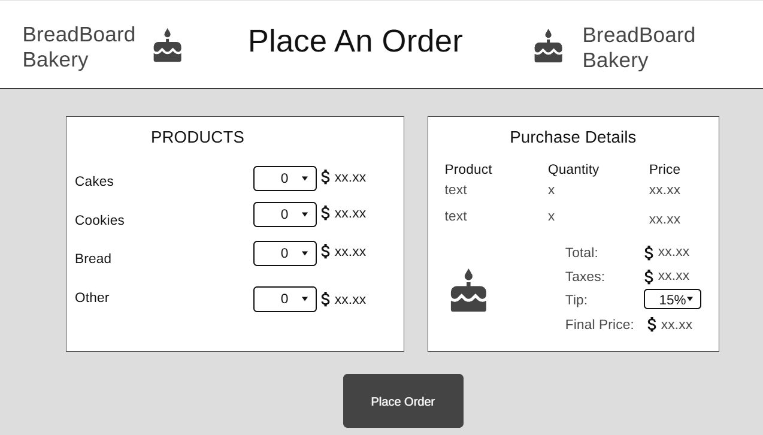
Mockup: Place an Order

Slide 12
04
Additional Functionality

Slide 13

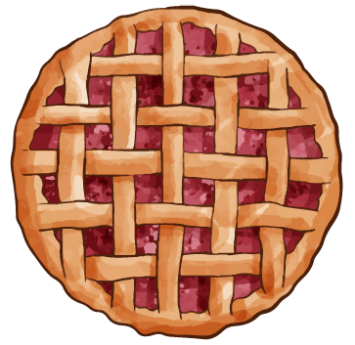


Additional Functionality
Gift Cards
Reward Points
Discounts
Repeat Order
The gift card feature allows customers to purchase gift cards for any occasion. It’s designed to be simple and user-friendly, encouraging more sales while spreading brand awareness and customer retention for the bakery.
This feature lets customers earn points from their purchases, which helps both the customer and the owner. It makes customers more likely to return, and it helps the owner see which customers buy regularly.
Introduce a discount system that allows customers to receive discounts based on specific conditions or promotions. This feature will enhance customer satisfaction and encourage repeat purchases.
Allows the customer to place a new order with the same items from their last order. This can be useful for customers that make repeat orders and could help users streamline the customer order
process.

